Slide 1

Modeling and simulation the resistance torque for specific wheel alignment in the Electric Power Steering system by using Matlab/Simulink and its application
Student name: Ho Binh Minh
Student ID: 1852169
Project instructor: Ph.D. Ngo Dac Viet
Ph.D. Tran Dang Long

Slide 2
Content Layout:
I/ Introduction:
II/ Theoretical basics:
III/ Specific vehicle steering equations:
Tire forces:
The resistance torque components
IV/ MATLAB/SIMULINK software:
V/ Result and discussion:
VI/ Conclusion and future plan:
VII/ References:

Slide 3
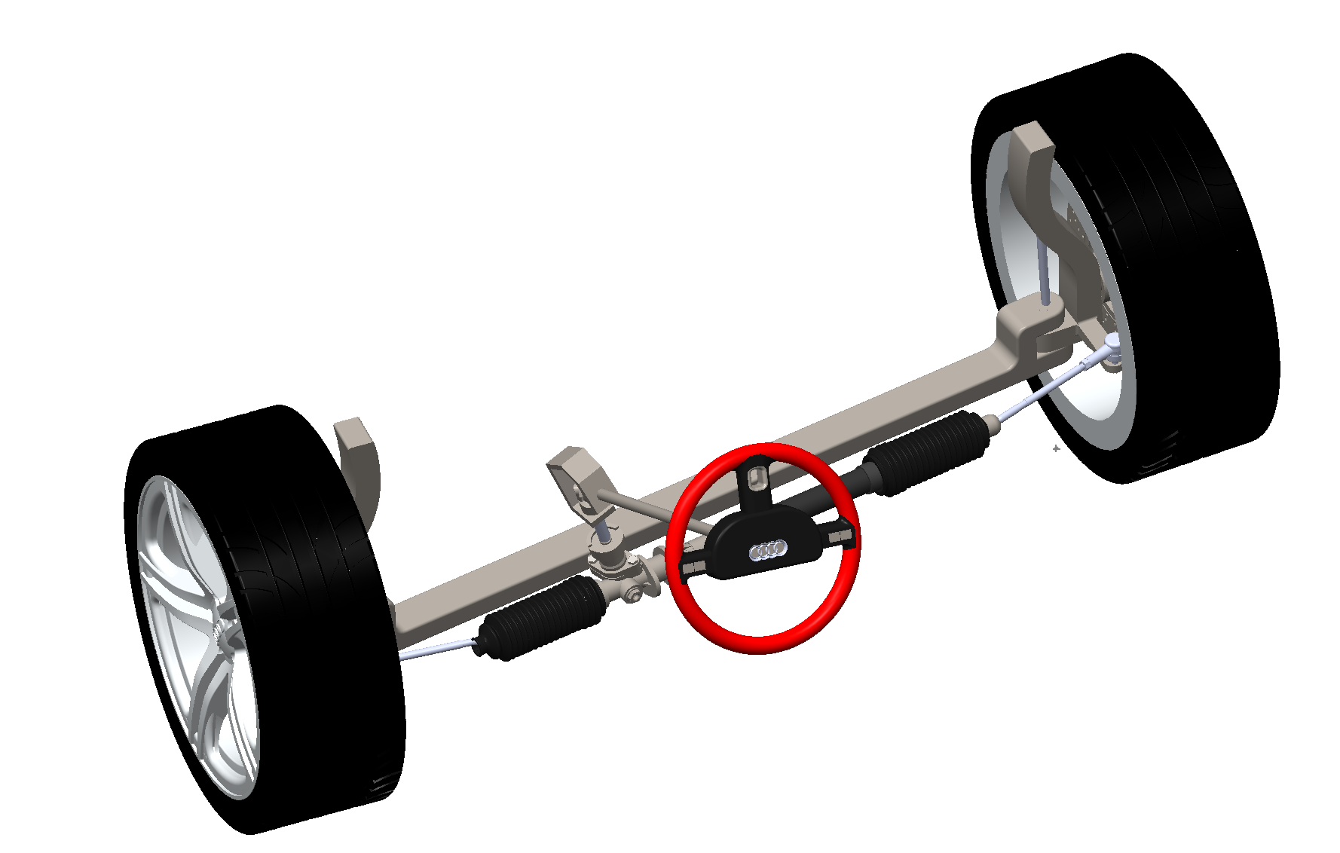
I. Introduction:
Figure : Solidworks steering system
The total resistance torque and wheel alignment affect to the steering driver efforts and vehicle’s stability.
Modeling and simulation the resistance torque for wheel alignment
Notes:
During the past years, steering mechanism and its relevant fields has been researched and developed in gradually increasing numbers. The steering system is one of the most important systems in a vehicle, providing the driver with both safety and comfort. One of the factors that greatly affects the steering system is the steering resistance torque, which opposes the driver's steering effort and requires more force to steer. This steering resistance torque comes from the interaction between the tire forces and the road surface, combined with the moment arm created by specific wheel alignment. In an electric power steering (EPS) system, it is necessary to calculate this steering resistance torque in order to provide the necessary assistance force from the motor during power assist. That is why in this entire project, I will focus on building mathematical models and simulations of the magnitude of this resistance torque under different driving conditions.

Slide 4
I. Introduction:
Scope of implementation:
This model is developed to simulate the total resistance torque in tire forces, specific wheel alignment and its relevant. Ignore all effects that is outside the scope of this project
Working condition:
Continuously change to adapt with variable driving conditions.
Technical requirement:
Working normally in above conditions.
Mission summary:
Fully understanding knowledge about the resistance torque between the tire force and road surface in steering mechanism especially in the EPS system
How wheel alignment and other factors can affect to the resistance torque in steering mechanism especially in the EPS system.
Notes:
During the past years, steering mechanism and its relevant fields has been researched and developed in gradually increasing numbers. The steering system is one of the most important systems in a vehicle, providing the driver with both safety and comfort. One of the factors that greatly affects the steering system is the steering resistance torque, which opposes the driver's steering effort and requires more force to steer. This steering resistance torque comes from the interaction between the tire forces and the road surface, combined with the moment arm created by specific wheel alignment. In an electric power steering (EPS) system, it is necessary to calculate this steering resistance torque in order to provide the necessary assistance force from the motor during power assist. That is why in this entire project, I will focus on building mathematical models and simulations of the magnitude of this resistance torque under different driving conditions.

Slide 5
I. Introduction:
Experimentally evaluate the functionality of the full total resistance torque model
Technical requirements and Objectives
Simulation results, conclusion and future plan
Design full mathematical model of total resistance torque
System investigation by test cases
Vehicle mass
The resistance torque components
Tire force calculation and relevant factors calculation block
Vehicle speed
The resistance by longitudinal forces
Vehicle wheel alignment
Modeling and simulation the total resistance torque for wheel alignment
The resistance by lateral forces
Steering wheel angle
The resistance by normal force

Slide 6
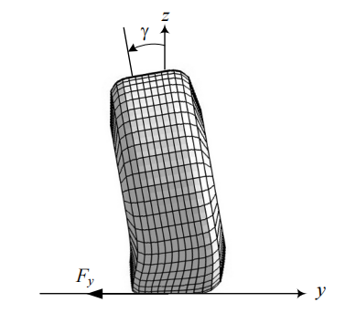
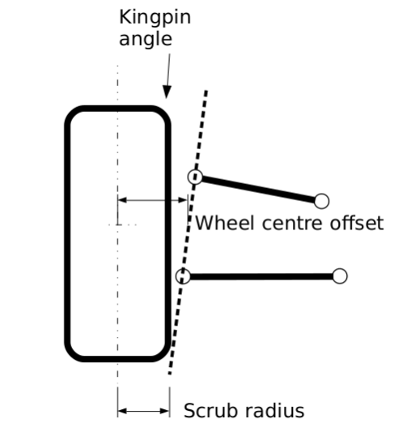
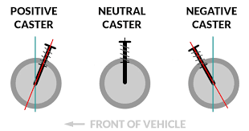
II. Theoretical steering basics:
Wheel Alignment:
Figure : Overall in Caster angle
Figure : Kingpin angle and its scrub radius
Figure : Camber angle at front view

Slide 7
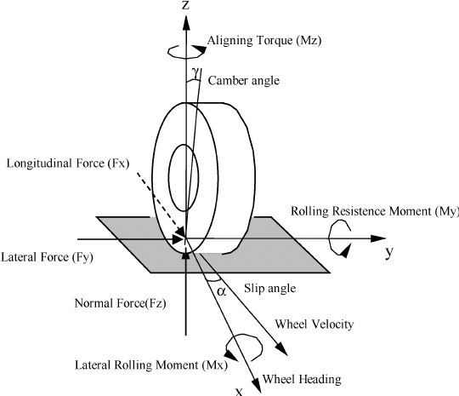

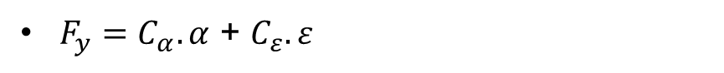
III. Specific vehicle steering equations:
1) Tire forces:
$F_{z}=m.g.\frac{a_{2}}{l}$
$F_{y}=C_{α}.α$ + $C_{ε}.ε$
$F_{rolling}= F_{z}.f$
Rolling resistance force (Fr)
$F_{x}=μ_{x}{.F}_{z}$
Figure : Overall tire forces and Kingpin angle

Slide 8
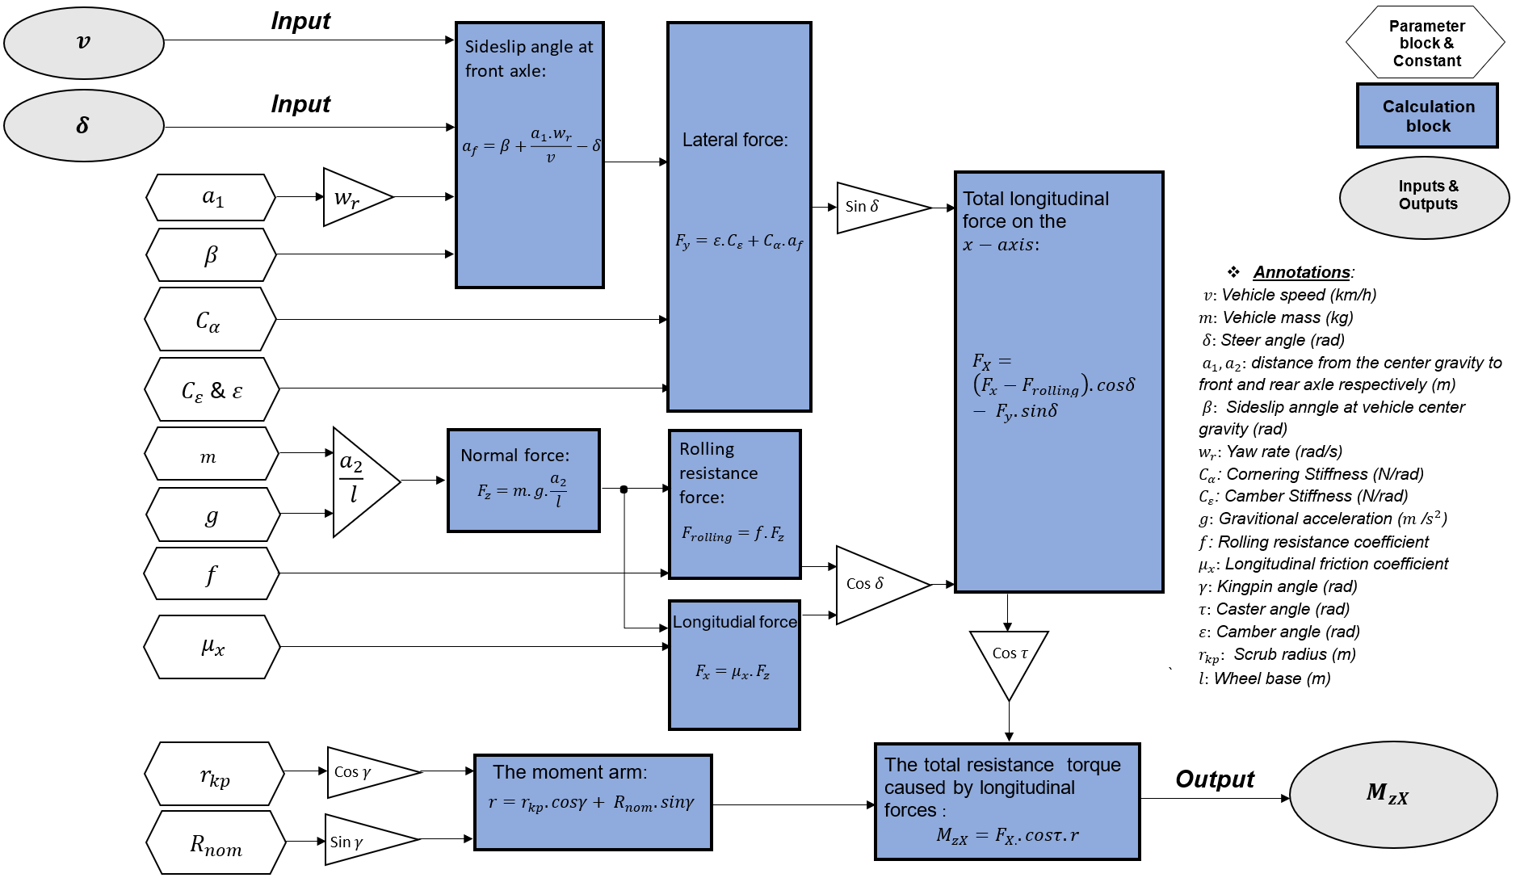
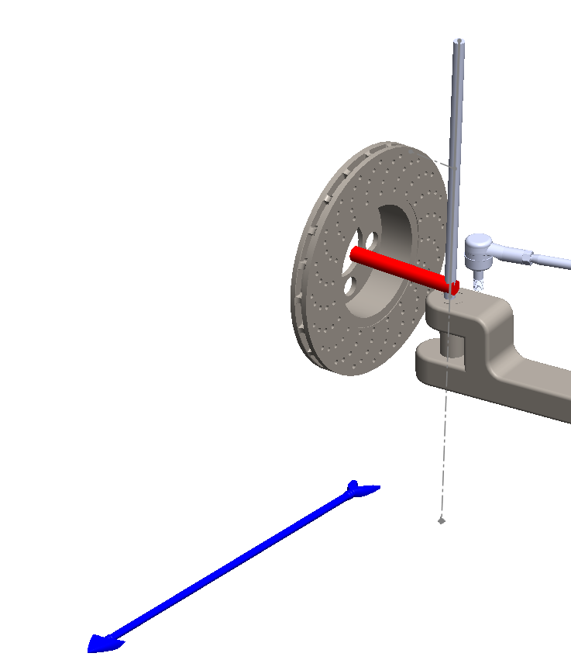
III. Specific vehicle steering equations:
2) The resistance torque:
FX

Slide 9
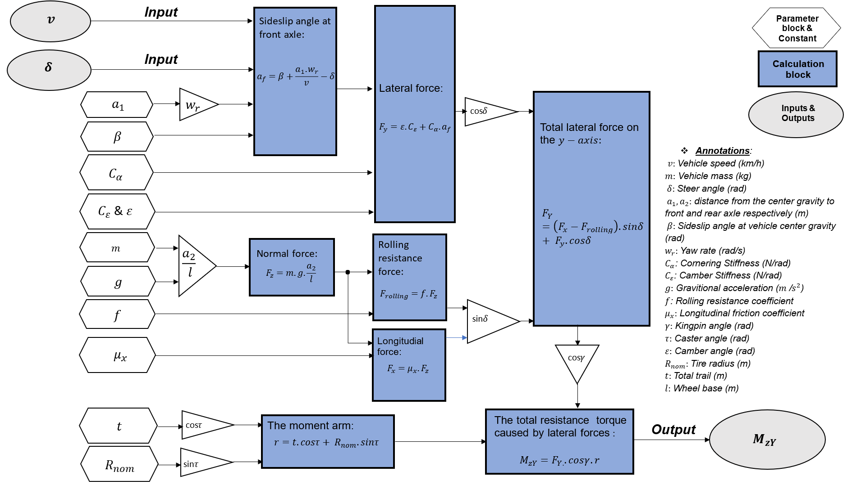
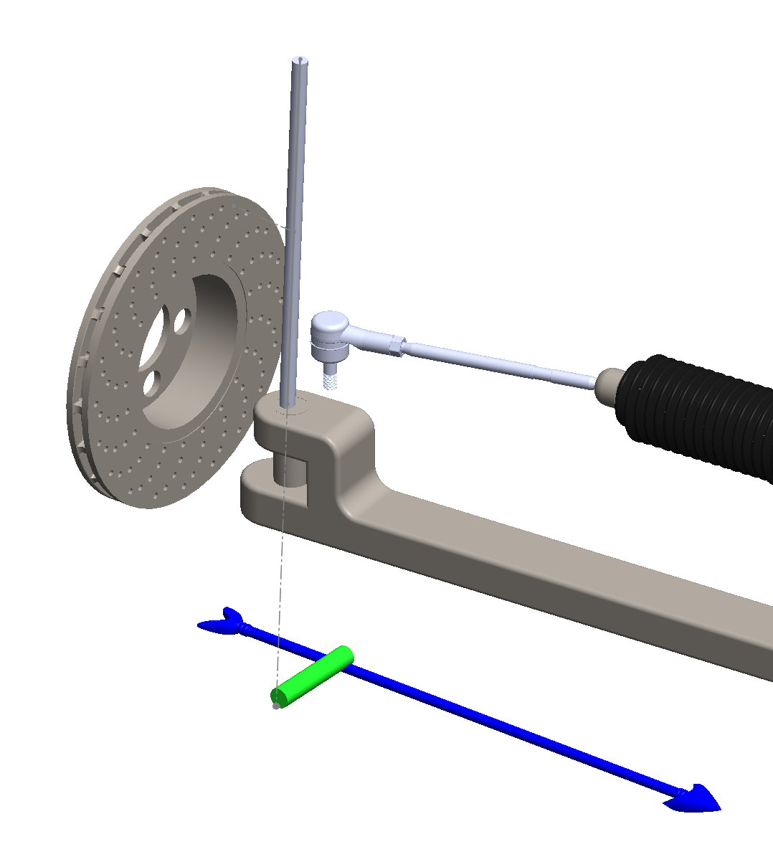
III. Specific vehicle steering equations:
2) The resistance torque:
FY

Slide 10
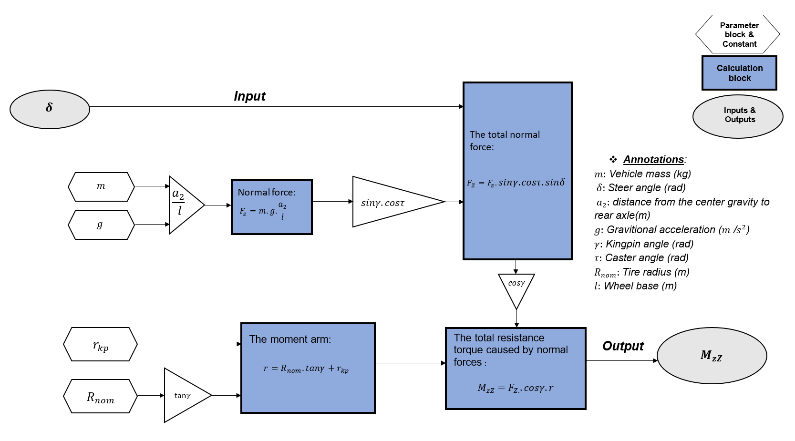
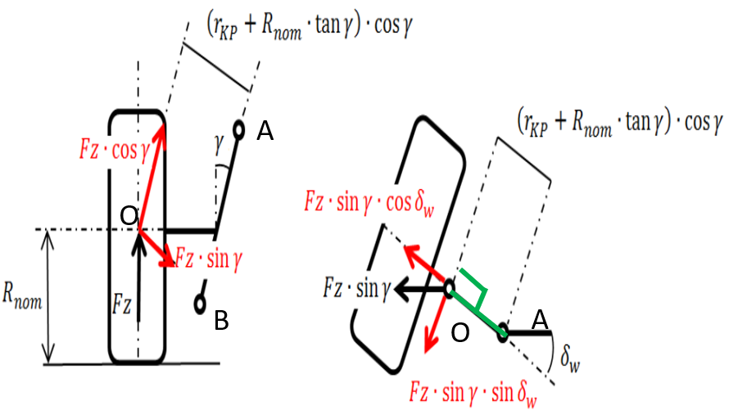
III. Specific vehicle steering equations:
2) The resistance torque:

Slide 11
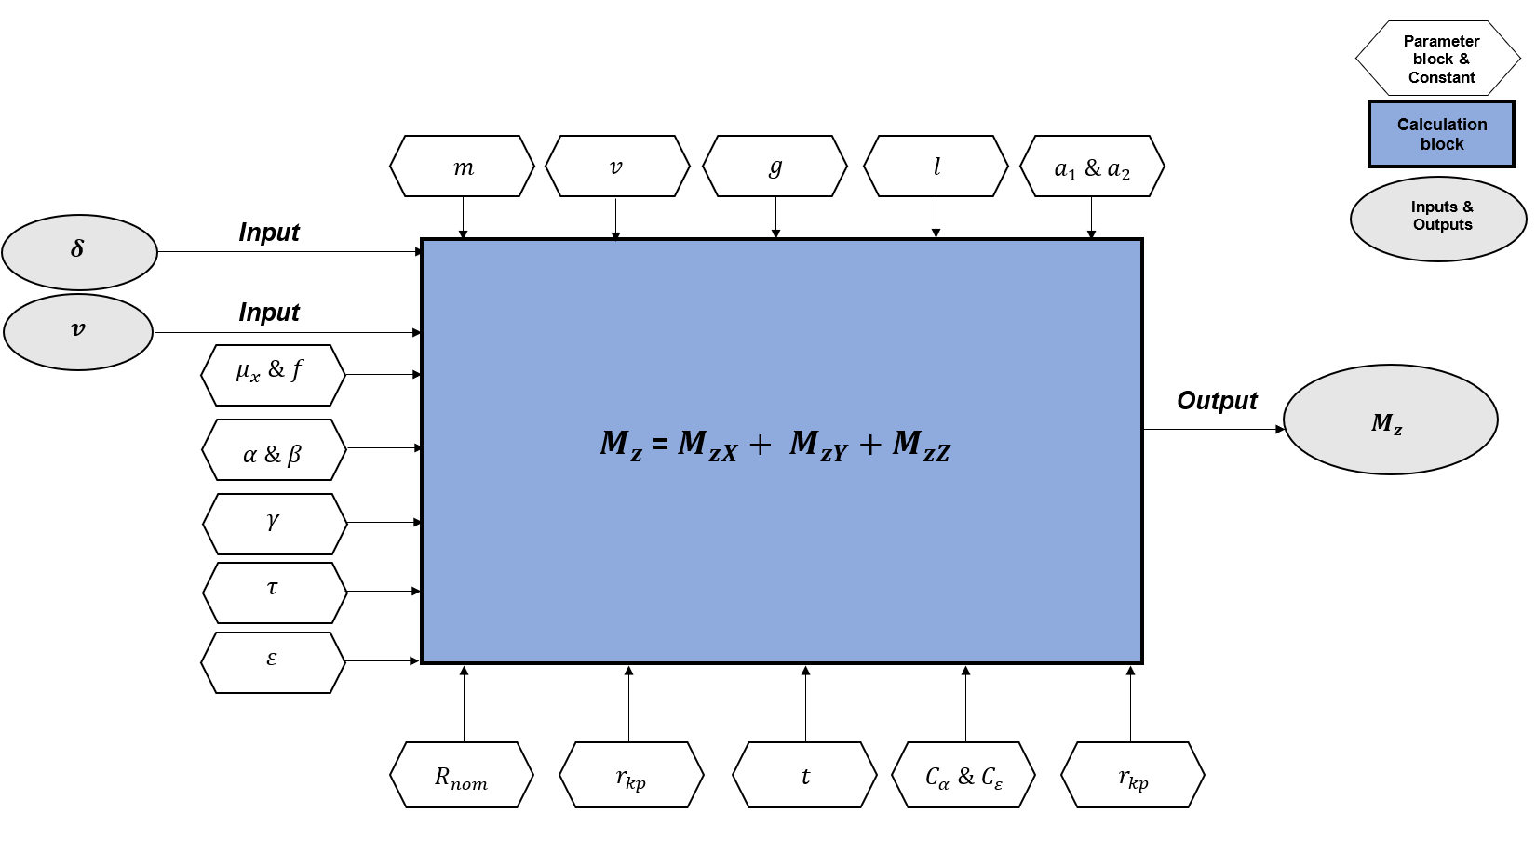
III. Specific vehicle steering equations:
2) The resistance torque:

Slide 12

IV/ Matlab/Simulink

Slide 13
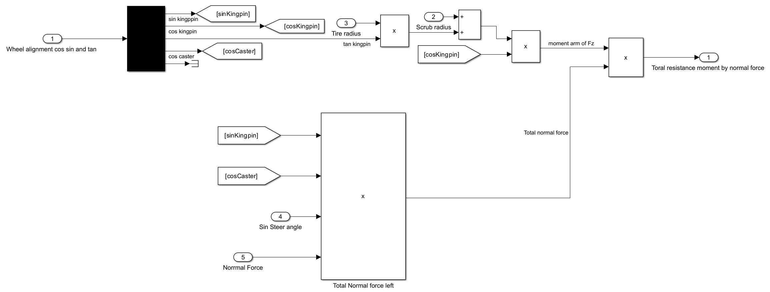
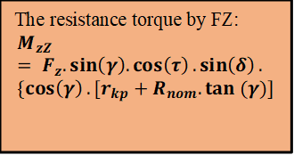
IV/ Matlab/Simulink

Slide 14
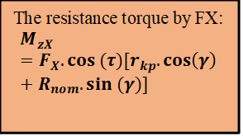
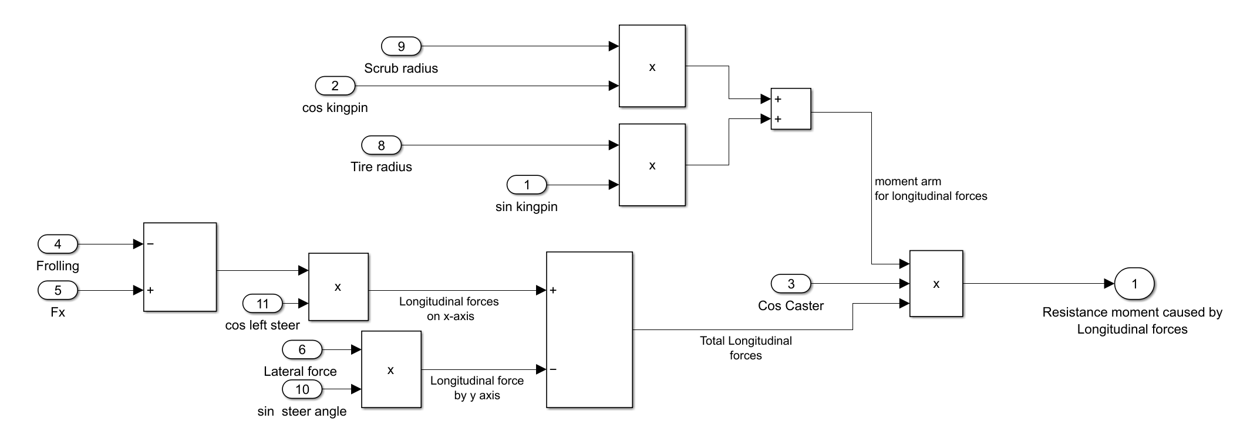
IV/ Matlab/Simulink

Slide 15
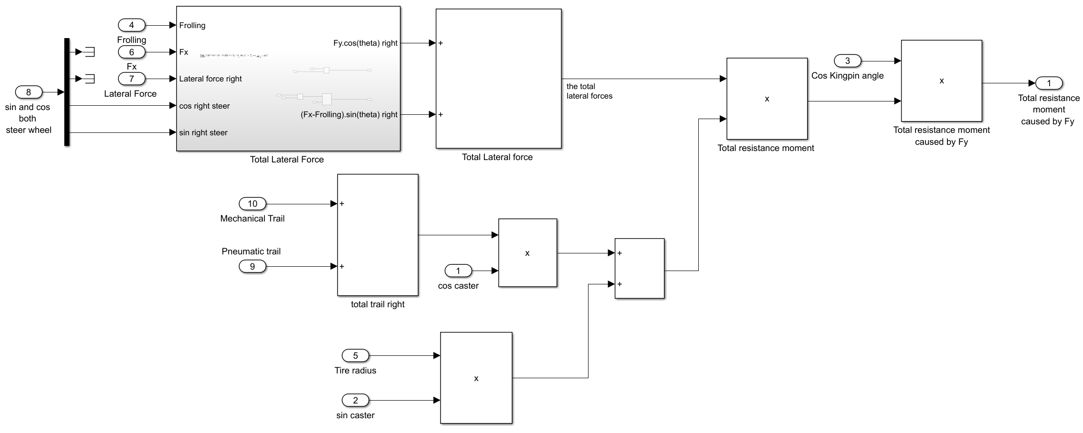
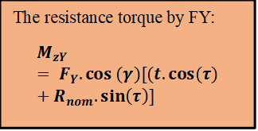
IV/ Matlab/Simulink

Slide 16
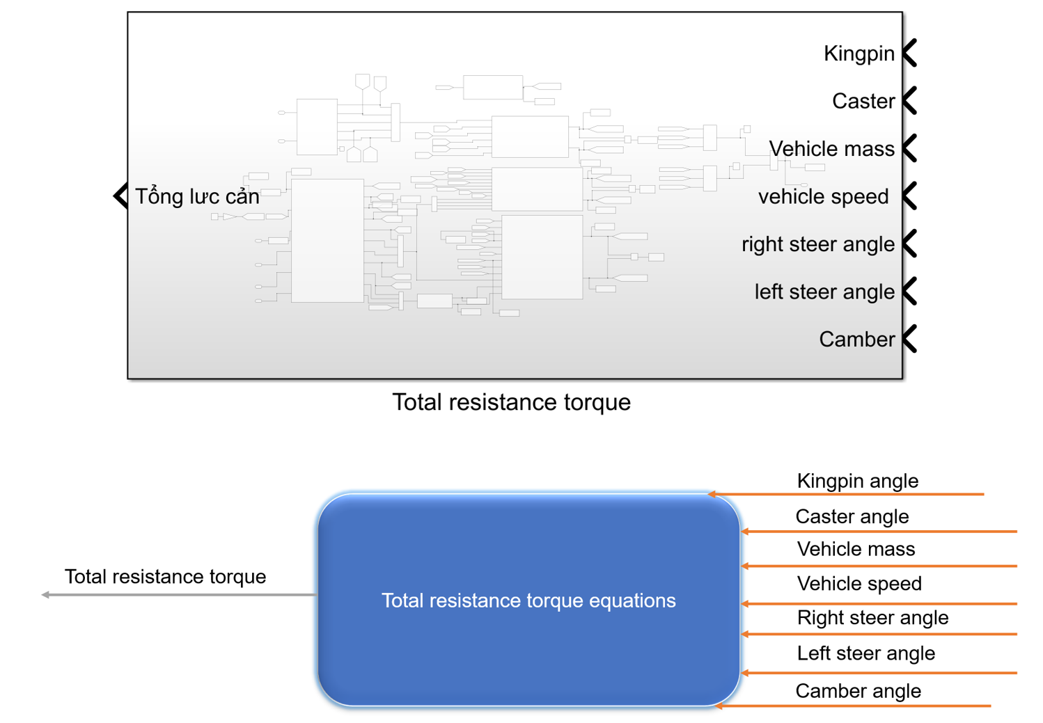
IV/ Matlab/Simulink

Slide 17
V/ Results and discussion:
Changing in vehicle mass
Changing in vehicle speed
Survey cases
Changing in vehicle wheel alignment
Changing in steering wheel angle

Slide 18
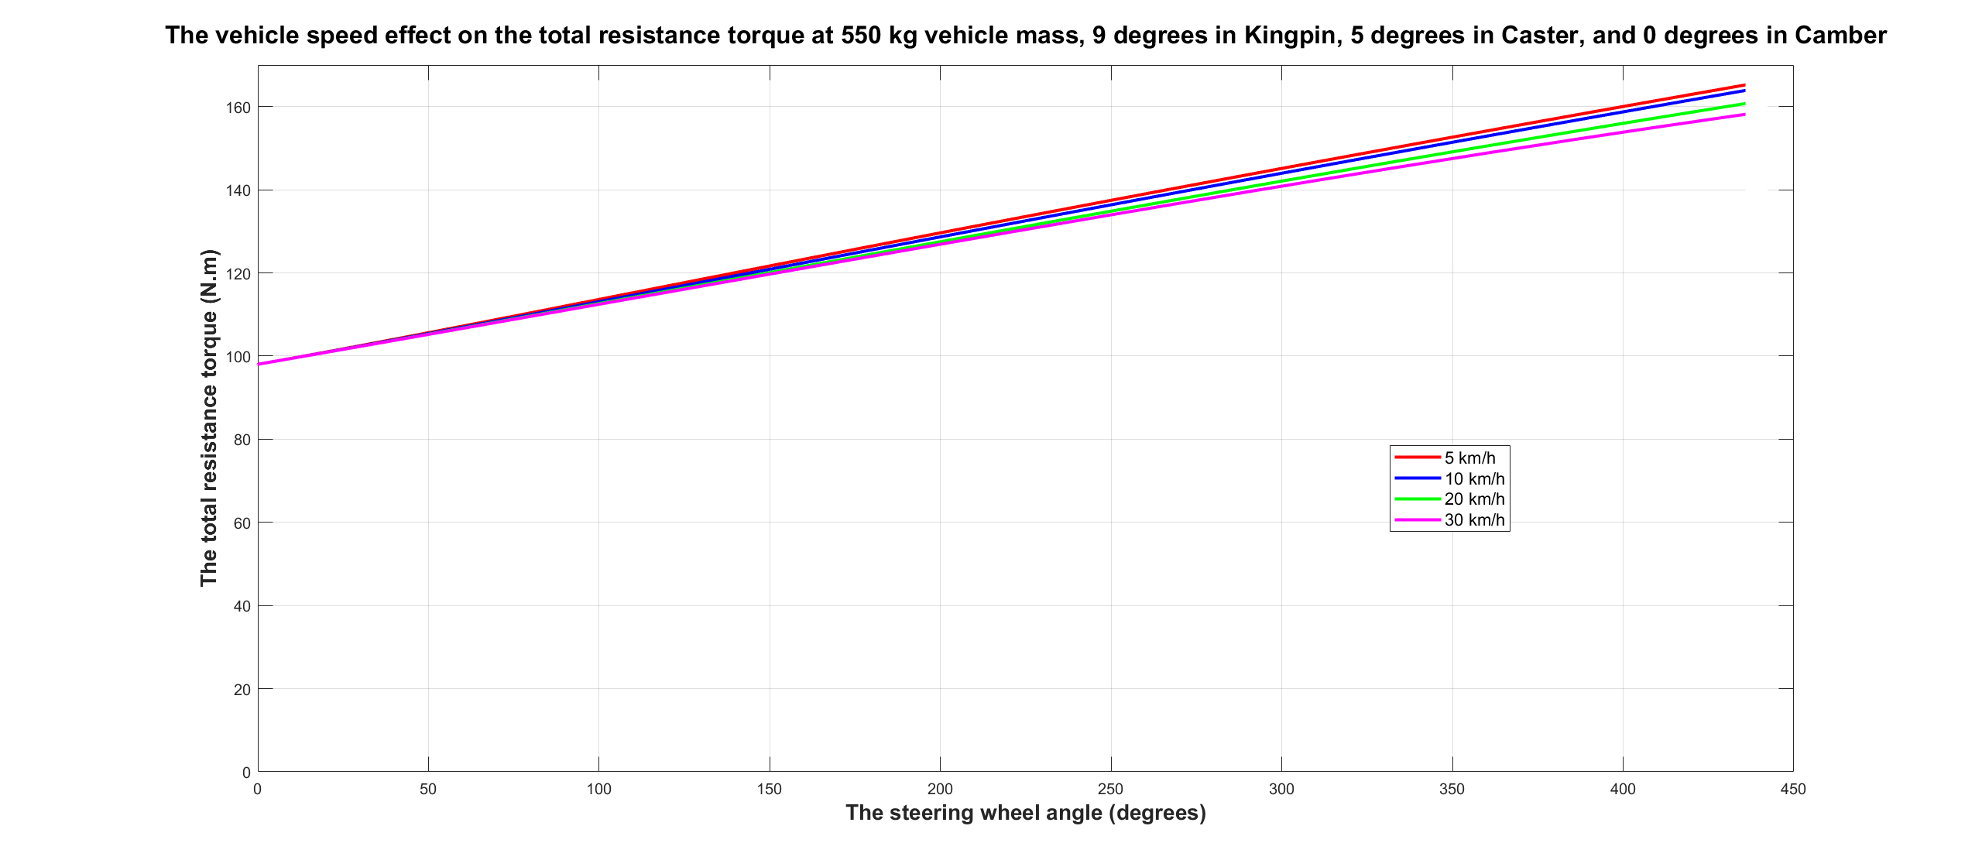
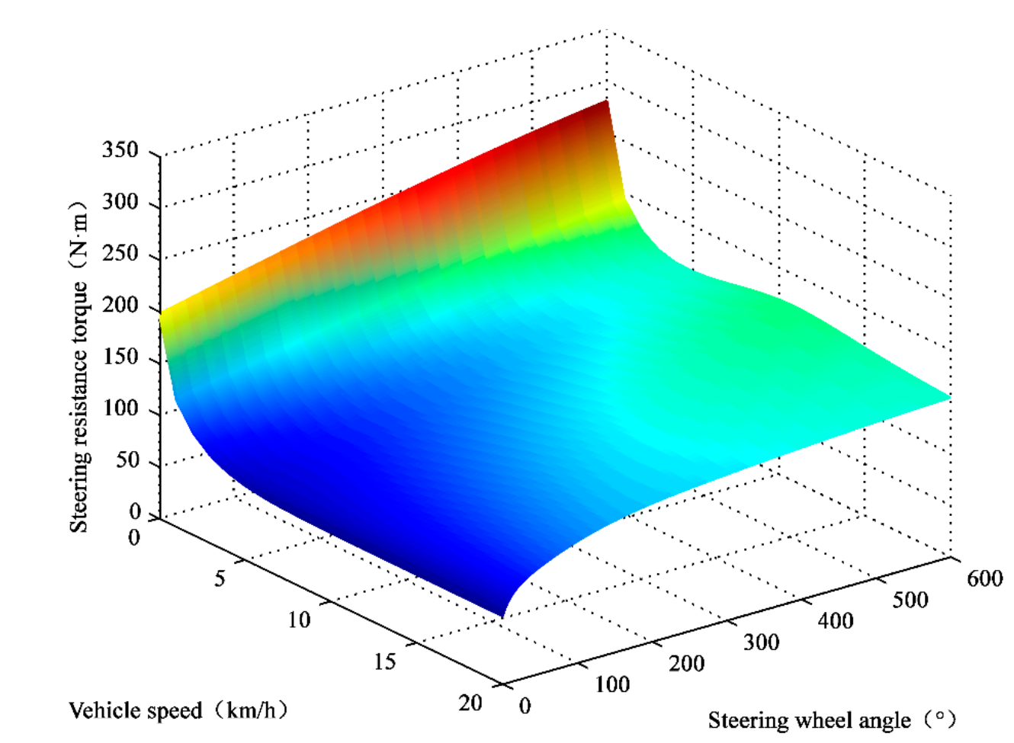
V/ Results and discussion:
Changing in vehicle speed
Total resistance torque decreases when vehicle speed increase

Slide 19
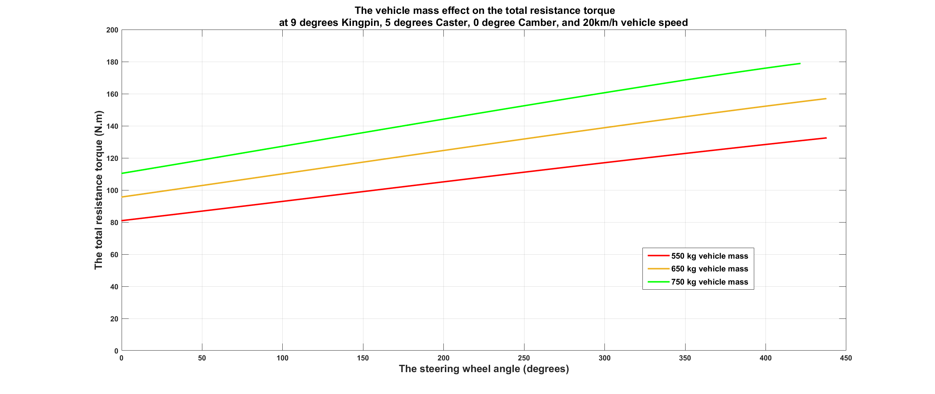
V/ Results and discussion:
Changing in vehicle mass
Total resistance torque increases when vehicle mass increases

Slide 20
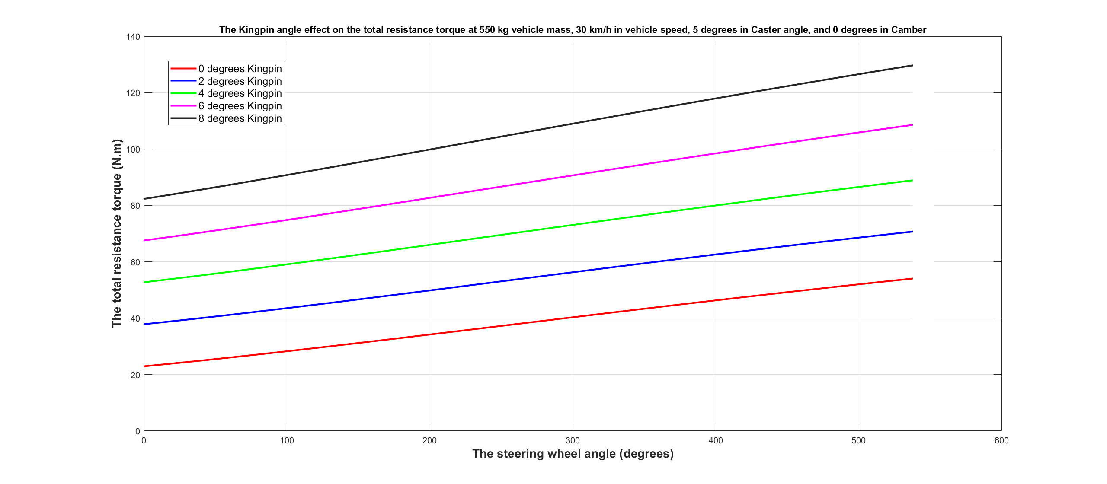
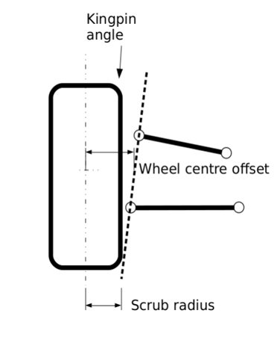
V/ Results and discussion:
Changing in Kingpin vehicle wheel alignment
Total resistance torque increases when Kingpin angle increases

Slide 21
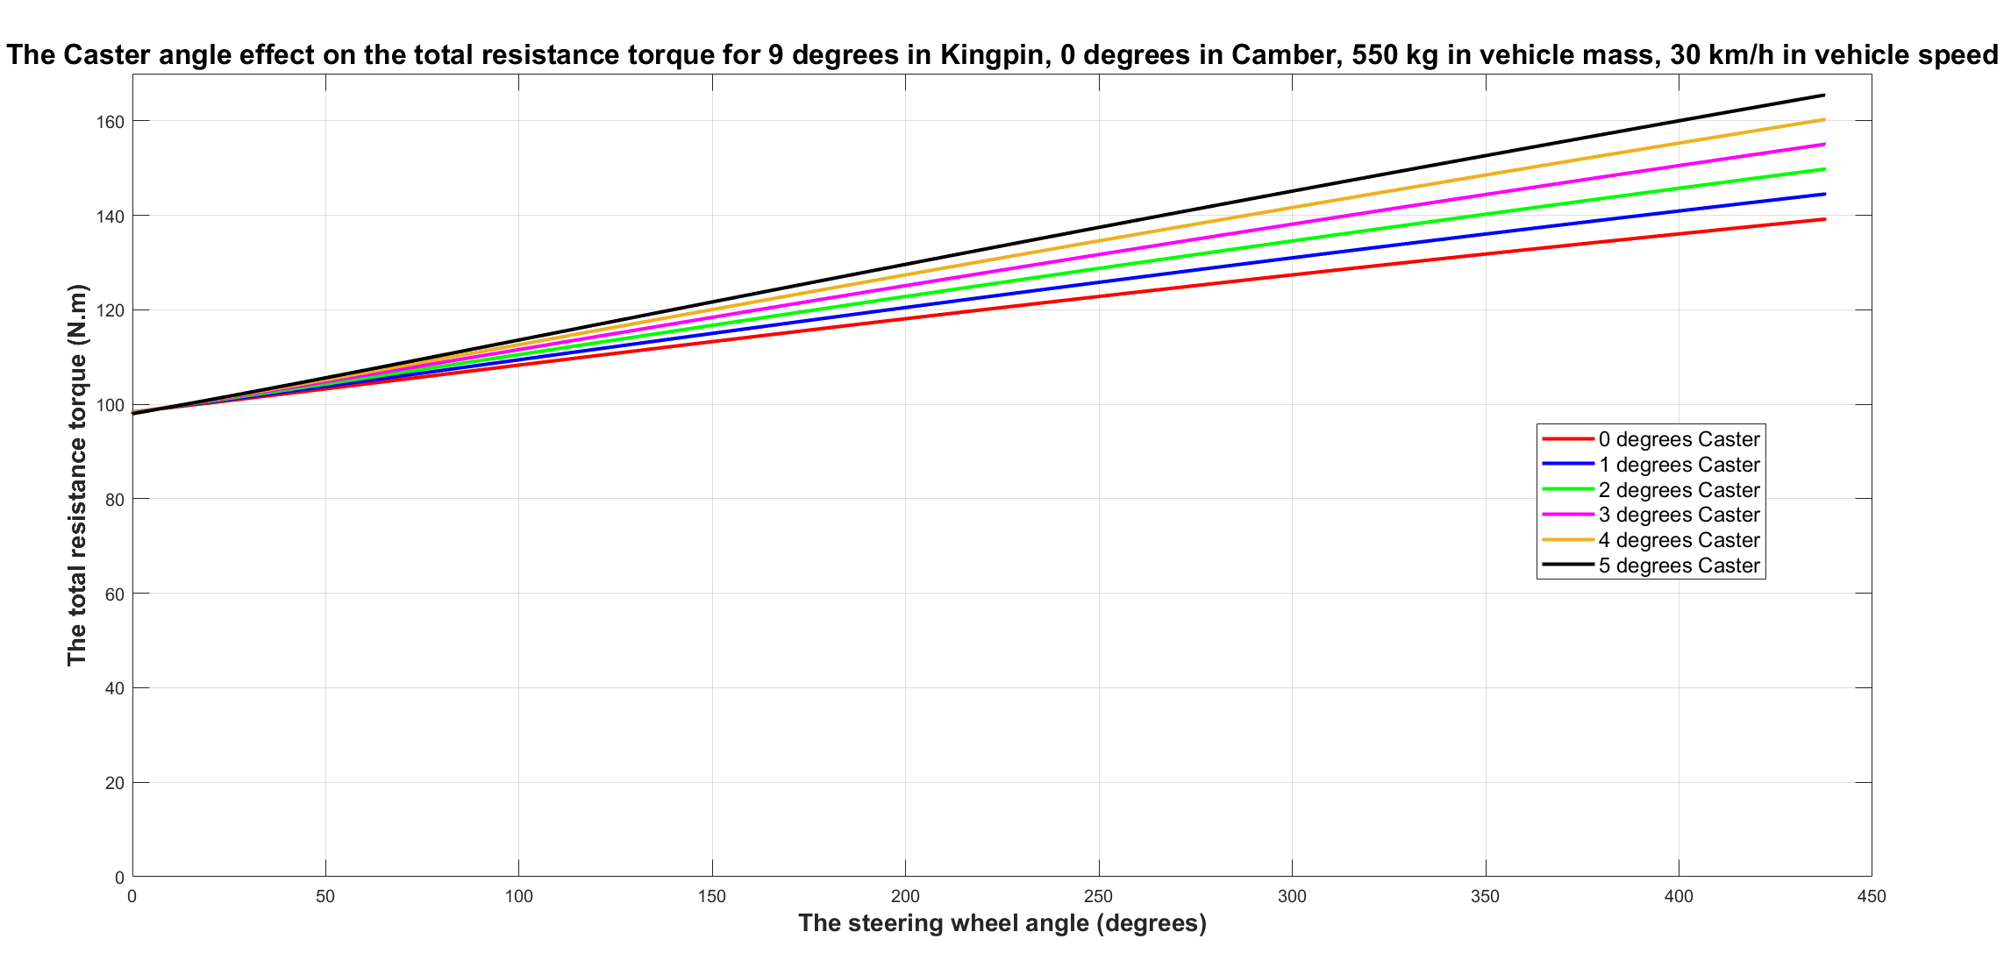
V/ Results and discussion:
Changing in Caster vehicle wheel alignment
Total resistance torque increases when Caster angle increases

Slide 22
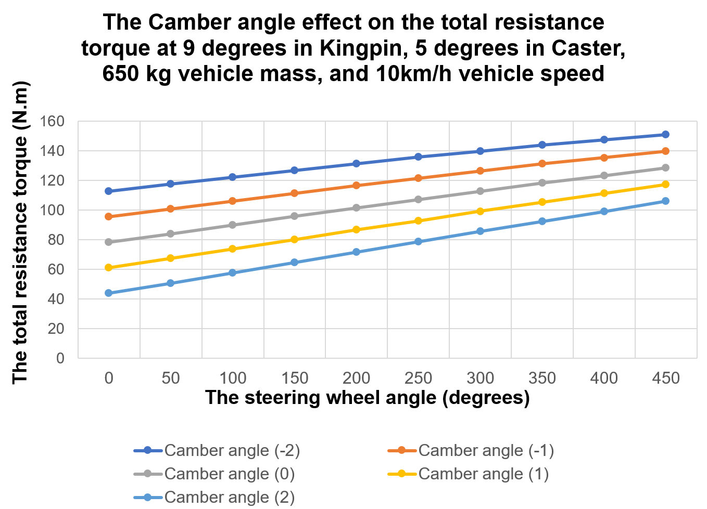
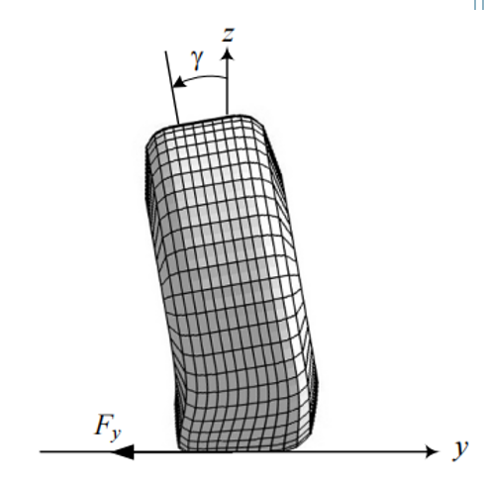
V/ Results and discussion:
Changing in Camber vehicle wheel alignment
Total resistance torque increases when negative Camber angle increases.
Total resistance torque decreases when positive Camber angle increases.

Slide 23
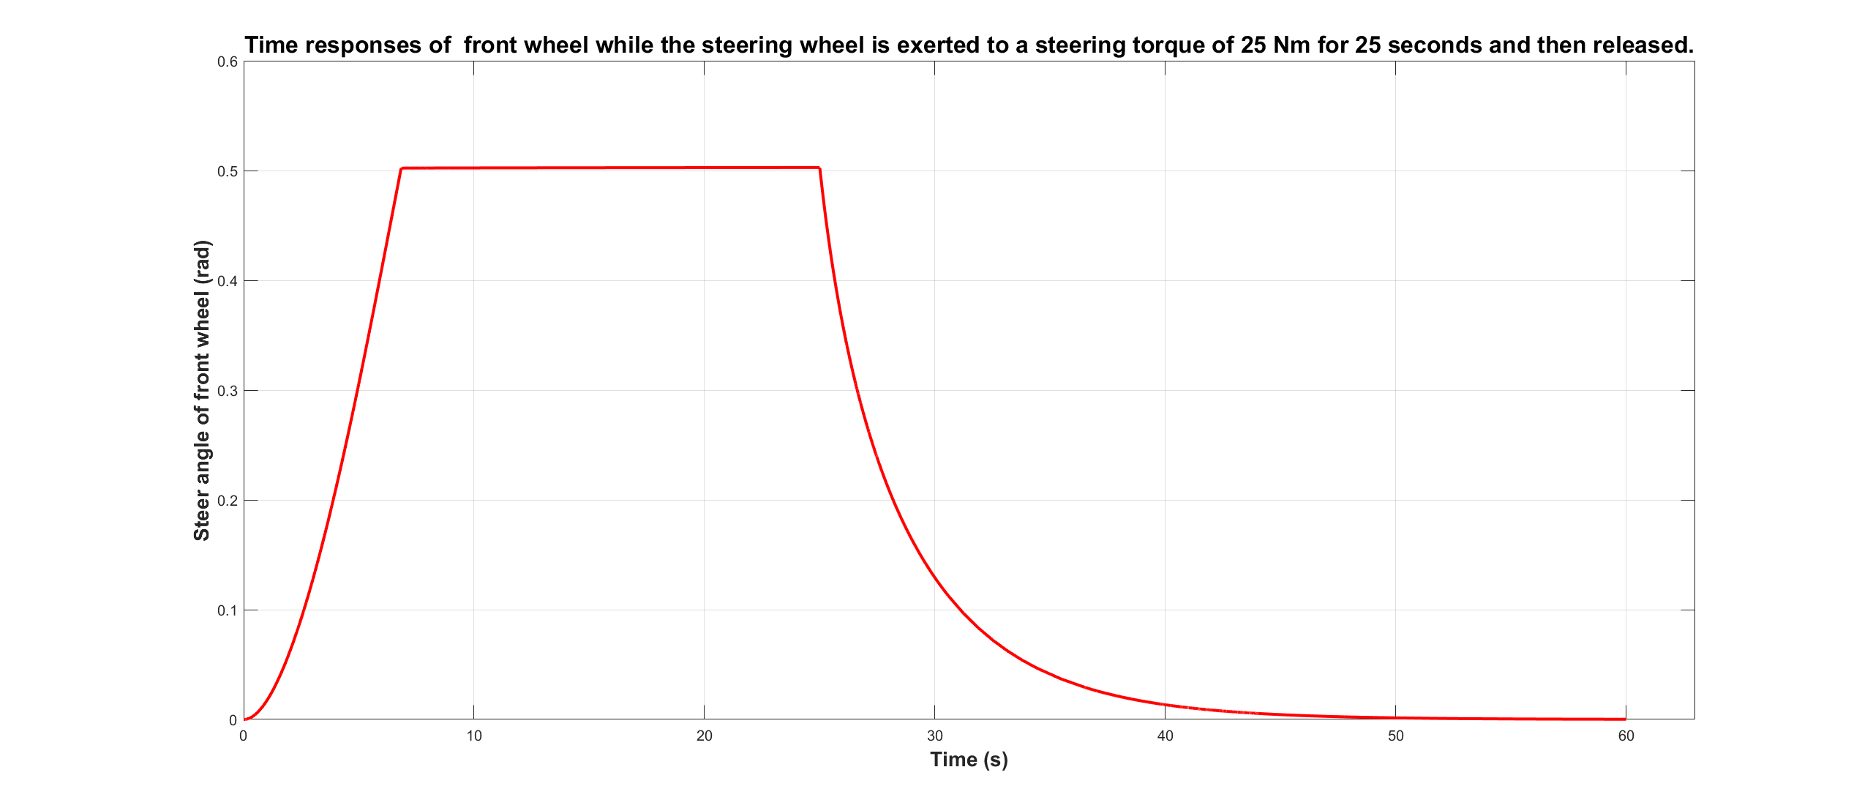
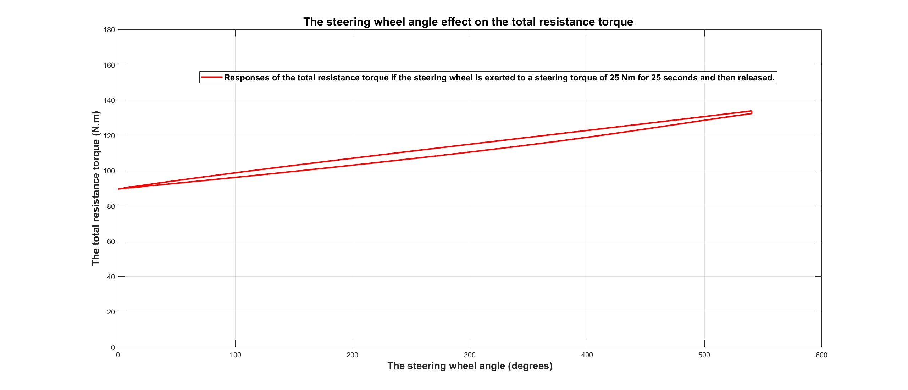
V/ Results and discussion:
Changing in steering wheel angle
Total resistance torque increases when steering wheel angle increases.

Slide 24
VI/ CONCLUSION AND FUTURE PLAN
Through all the figures mentioned above, we can conclude that wheel alignment has the huge impact on the total steering resistance torque in collaboration with vehicle mass and vehicle speed.
In the future, it is recommended to develop this steering mechanism model and going further to simulate different situations.
Notes:
The main conclusion obtained in this Capstone project is how the wheel alignment especially Caster angle and Kingpin angle affect to the resistance moment in collaboration with specific factors such as vehicle mass, vehicle velocity,… Through all the figures mentioned above, we can conclude that wheel alignment has the huge impact on the total steering resistance torque in collaboration with vehicle mass and vehicle speed.
In the future, I will continue to develop this steering mechanism model and going further to simulate different situations by assist simulator such as Matlab/Simulink base on all relevant theories that mentioned in this Capstone project to provide the exact results in comparison with reality.

Slide 25
VII/ References:
Jazar, R. N. (2017). Vehicle Dynamics: Theory and Application (3rd ed. 2017). Springer.
Lenzo, B. (2021). Vehicle Dynamics: Fundamentals and Ultimate Trends (CISM International Centre for Mechanical Sciences, 603) (1st ed. 2022). Springer.
Cossalter, V. (2006). Motorcycle Dynamics (2nd ed.). Lulu.com.
Reimpell, J., Stoll, H., Betzler, J. W., & Engineers, S. O. A. (2022). The Automotive Chassis: Engineering Principles (2nd ed.). Society of Automotive Engineers.
American Association of State Highway and Transportation Officials. (2022). A Policy on Geometric Design of Highways and Streets 2011 (6th ed.). Amer Assn of State Hwy.
Wikipedia contributors. (2022, September 13). Vehicle dynamics. Wikipedia. https://en.wikipedia.org/wiki/Vehicle_dynamics
Pauwelussen, J. (2014). Essentials of Vehicle Dynamics (1st ed.). Butterworth-Heinemann.
Hu, C. H. (2008). Modeling and Simulation of Automotive Electric Power Steering System. 2008 Second International Symposium on Intelligent Information Technology Application. https://doi.org/10.1109/iita.2008.51
Notes:
The main conclusion obtained in this Capstone project is how the wheel alignment especially Caster angle and Kingpin angle affect to the resistance moment in collaboration with specific factors such as vehicle mass, vehicle velocity,… Through all the figures mentioned above, we can conclude that wheel alignment has the huge impact on the total steering resistance torque in collaboration with vehicle mass and vehicle speed.
In the future, I will continue to develop this steering mechanism model and going further to simulate different situations by assist simulator such as Matlab/Simulink base on all relevant theories that mentioned in this Capstone project to provide the exact results in comparison with reality.

Slide 26
Thank You

Slide 27
V/ Results and discussion:
Changing in vehicle speed
Total resistance torque decreases when vehicle speed increase

Slide 28
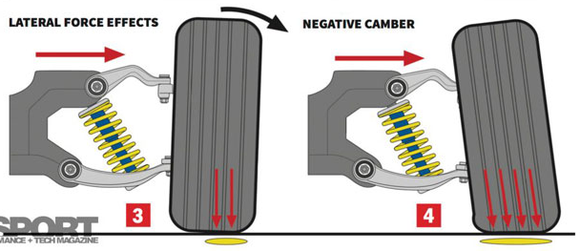

Slide 29
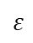
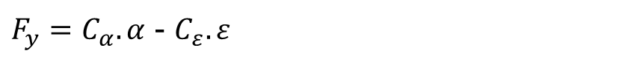
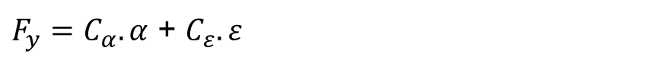
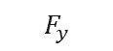
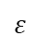
$$ε$$
$$ε$$
$$F_{y}$$
$F_{y}=C_{α}.α$ + $C_{ε}.ε$
$F_{y}=C_{α}.α$ - $C_{ε}.ε$
Notes:
camber thrust may contribute to or subtract from the total centripetal force generated by the tire, depending on the camber angle
Centrifugal: li tâm
Centripetal: hướng tâm

Slide 30
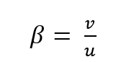
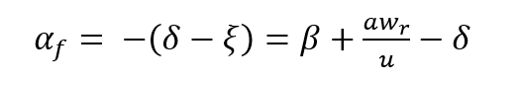
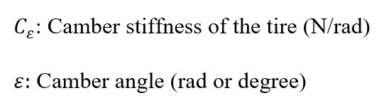
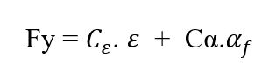
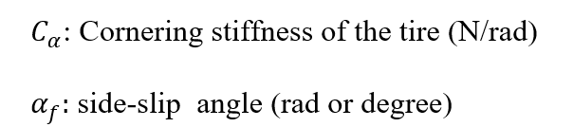
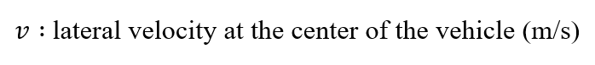
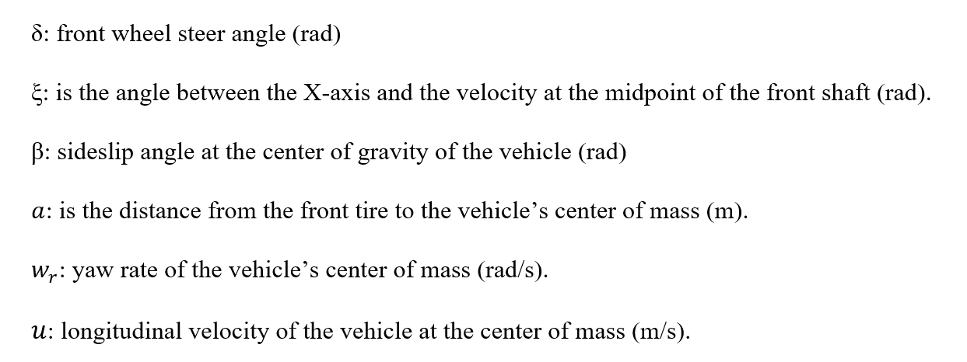
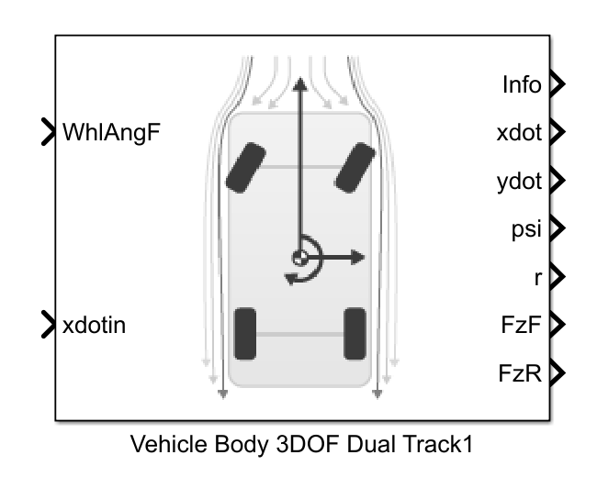

Slide 31
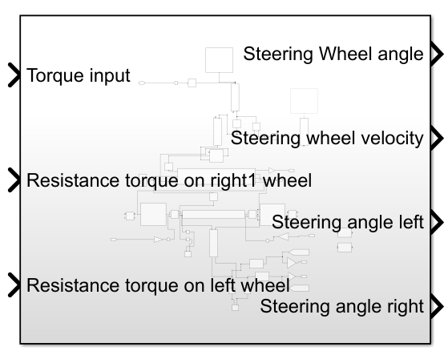

Slide 32
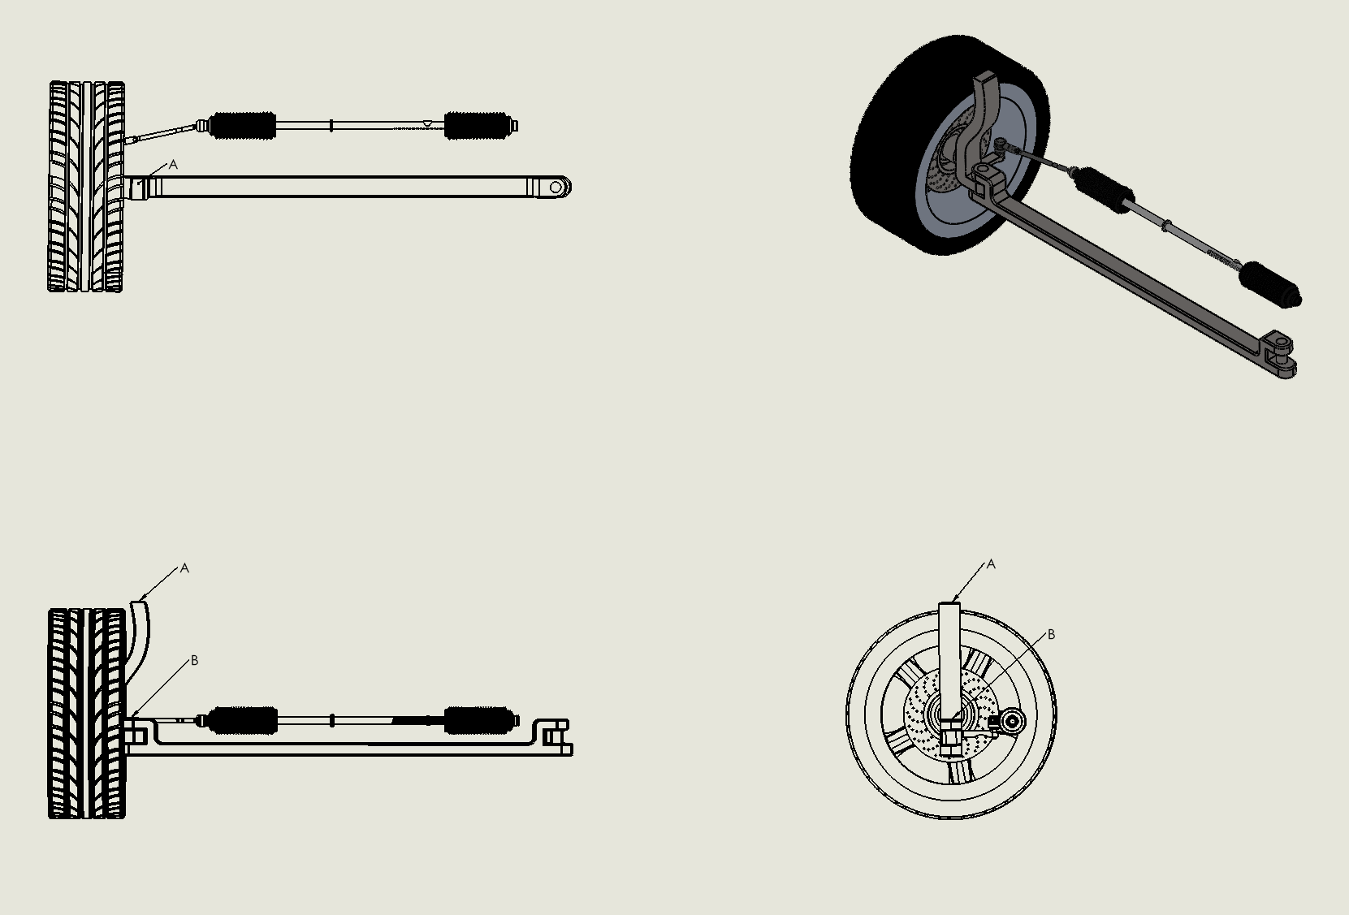
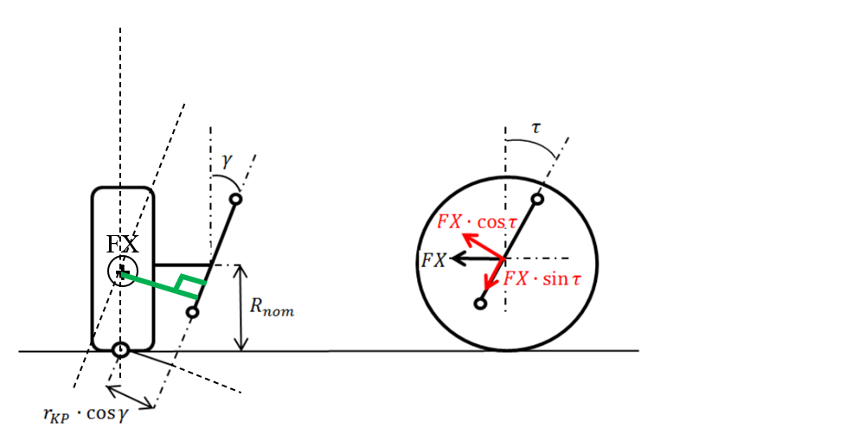
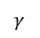
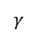
A
Top View
Fx
Front view
B
A
A
Fx
$$γ$$
B
B
$$γ$$
Side view
Fx
Side View
Fx
+
.
Front View

Slide 33
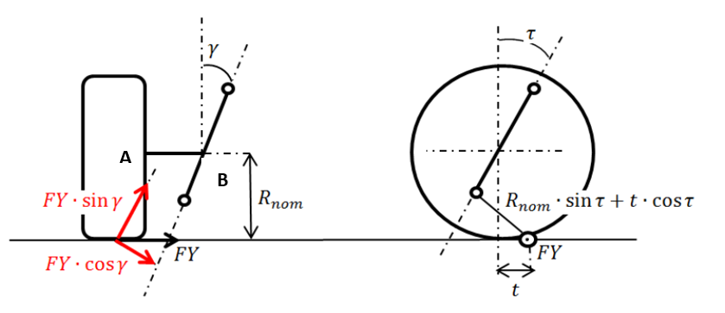

A
Top View
FY
Front view
Side view
B
A
A
A
Fx
$$γ$$
O
B
B
D
B
$$τ$$
$$γ$$
Side view
$$R_{nom}.sin⁡(τ)$$
t$.cos⁡(τ)$
Side View
Front View
+
+
FY
FY

Slide 34

A
Fz
O
+
Top View
O
B
A
Fx
$$γ$$
O
FZ
B
O
A
FZ
O
Side View
Front View

